Slide 1
Chill Coach Club Application
CS-331-01 Project

Slide 2
Watch Party application
In the zoom era, personal interactions are limited. Through watch party applications you can watch the media you like with friends or stranger with similar interests.
People can host watch parties, join watch parties or interact with others who they met through the application.
We call the application Chill Couch Club. ( C club )
Notes:
Samar

Slide 3
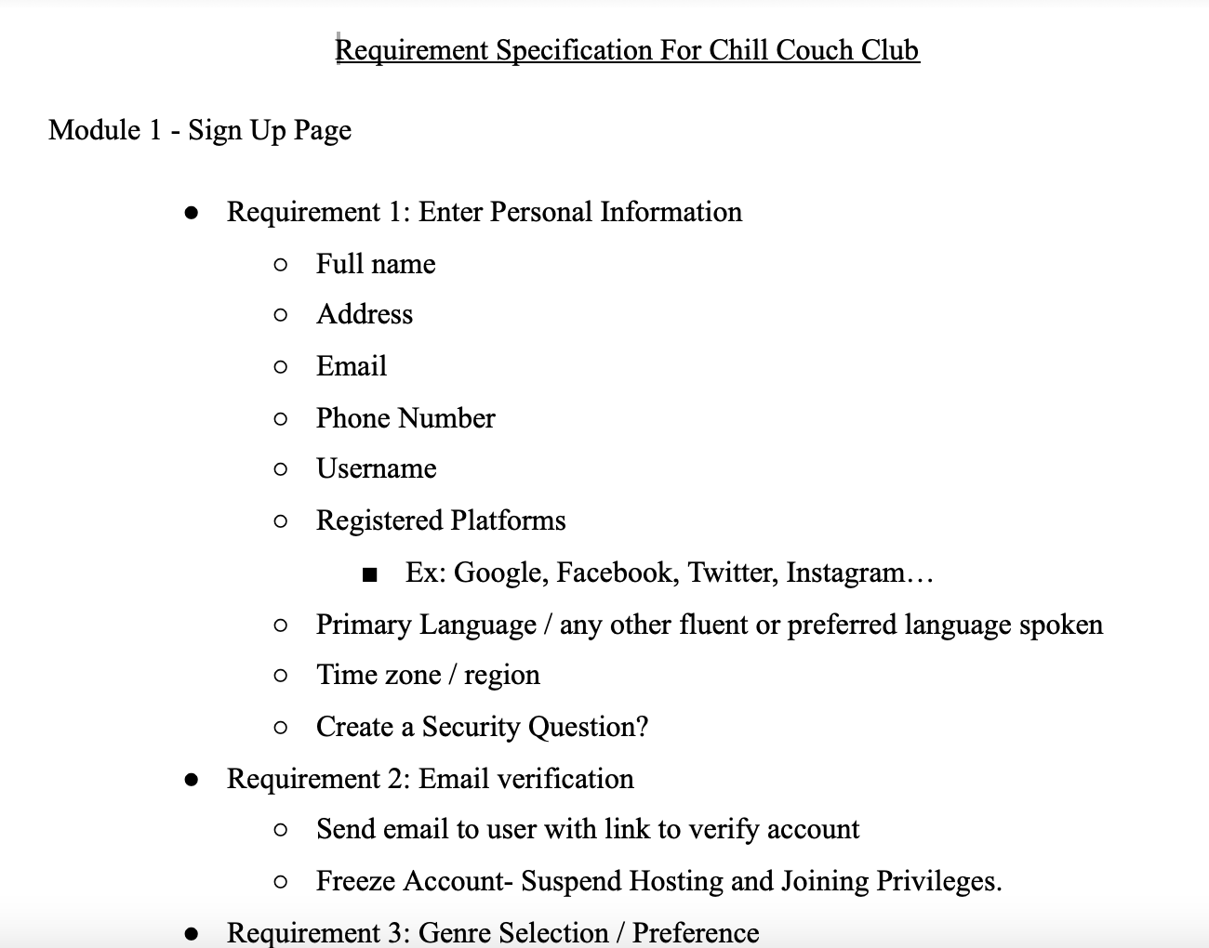
Project Specification
Project Specification
module 1: Sign up page
Module 2: Upgrade to Premium
Module 3: Sign in page
Module 4: Forget password
Module 5: Movie Catalogue
Module 6:Hosting a party
Module 7: Joining a party
Notes:
Jimmy

Slide 4
Functional / Non Functional Specifications
Non Functional Specifications:
User Credentials
Premium Users
Non-Premium Users
User access to outside platforms
Platform running on streaming service
Portability
Security Features
Performance
Compatibility
Reliability
Localization
Usabiliity
Functional Specifications
Application | Sample use case | Corresponding user story
Party hosting system | User hosting a party | As a user I want to host a party so that I can watch the party with other users on the platform.
Party participation system | User joining a party that’s been hosted | As a user I want to attend the ongoing or future parties so that I can watch and interact with other users.
Premium sign up system | User signing up for premium | As a user I want to sign up for premium so that i can use the premium services provided by the application.
Premium privilege System | User using premium functions | As a premium user I want to access premium functions that enhance my user experience.
Notes:
Jacob

Slide 5

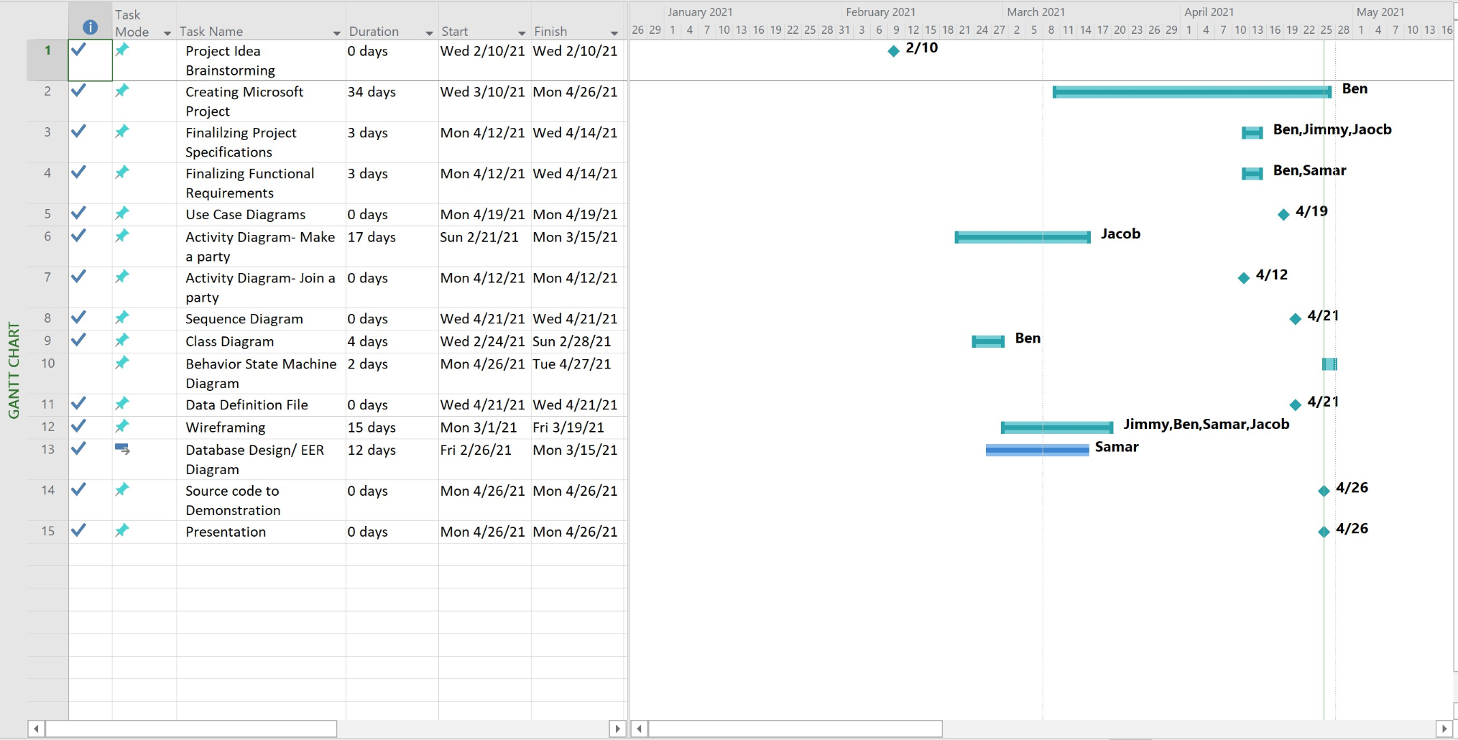
Microsoft Project
Notes:
Ben
Constantly being reworked may have been more harm than good

Slide 6
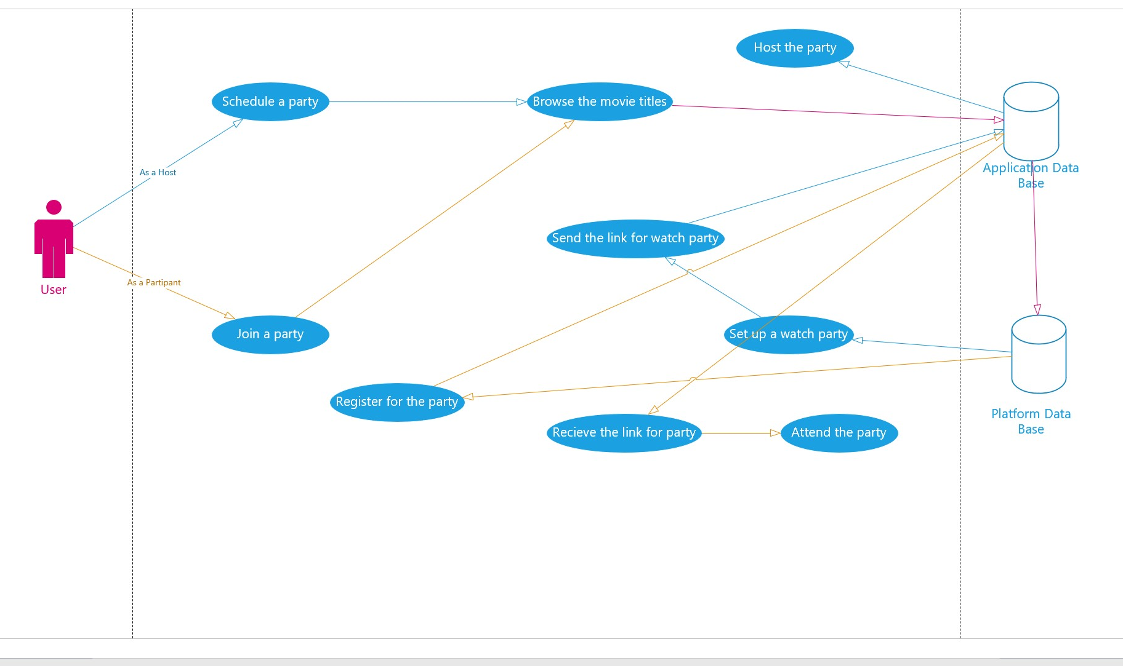
Use-Case Diagram
Interaction between the user and the system:
The relevant user
What service that user want system provide
Service user need to provide for the system
Notes:
Samar

Slide 7
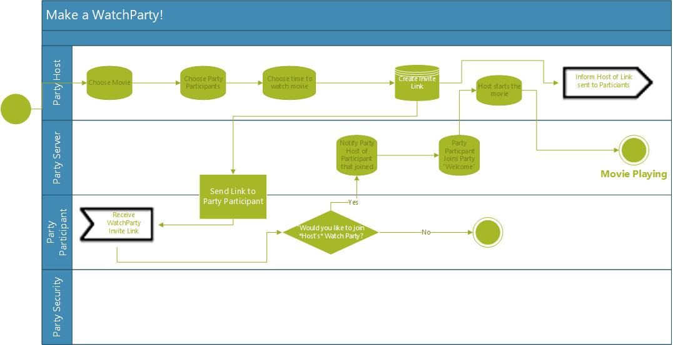
Activity Diagram - Making a WatchParty

Slide 8
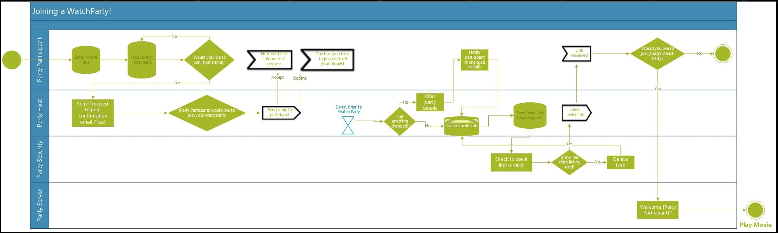
Activity Diagrams - Joining a Party
Notes:
Jacob

Slide 9
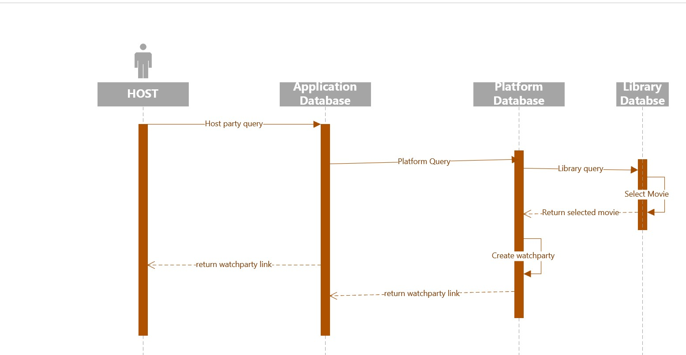
Sequence Diagram
Notes:
Samar

Slide 10
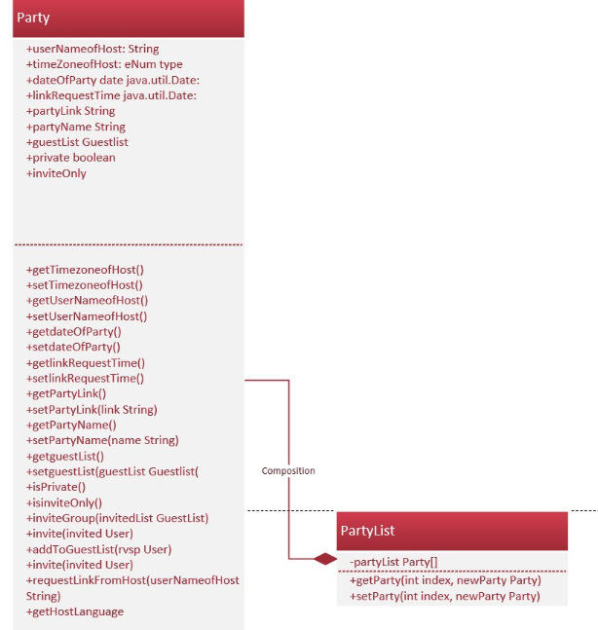
Class Diagrams:
Party List
Notes:
Ben Party has a composition
Relationship with party List

Slide 11
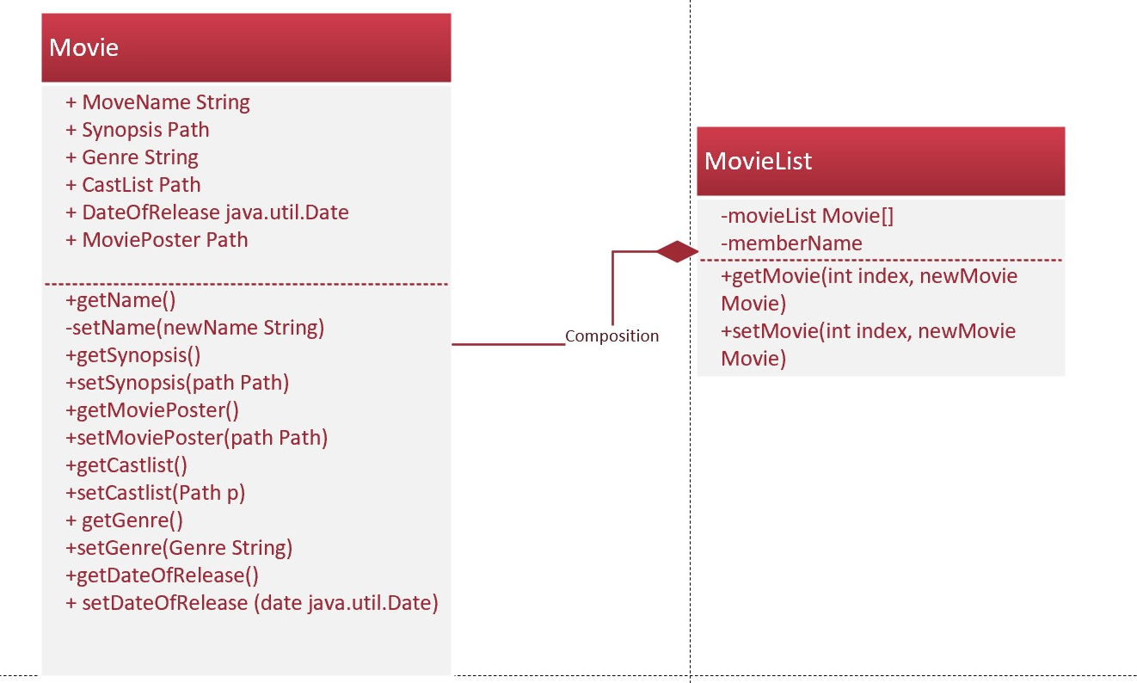
Class Diagram: Movie/ Movie List
Notes:
Ben

Slide 12
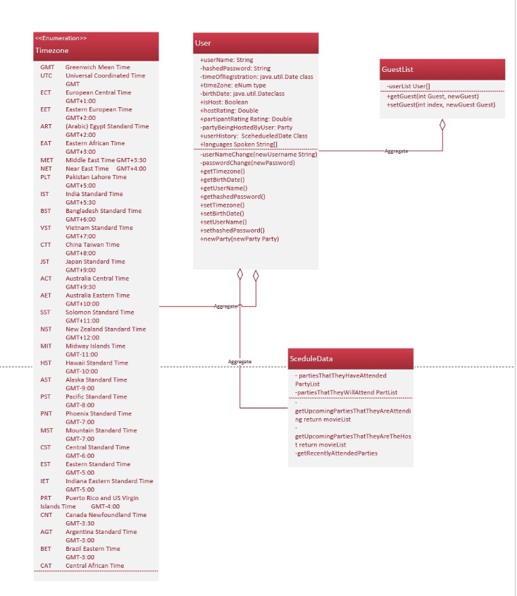
Class Diagram: User/ Scedule Data/Guestlist/ Timezone
Notes:
Ben

Slide 13
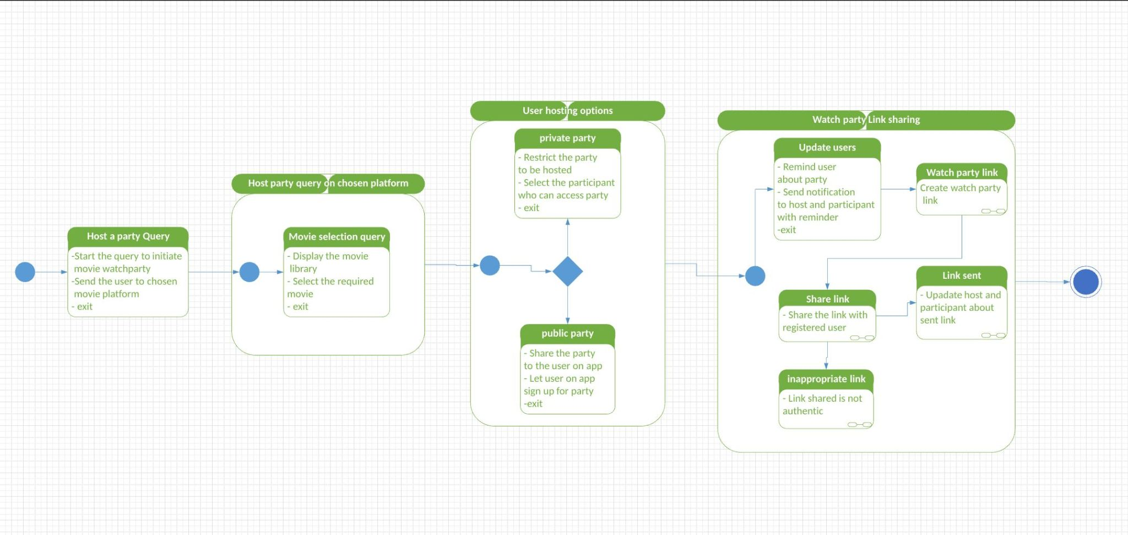
Behavioral State Machine Diagram
Notes:
Samar

Slide 14
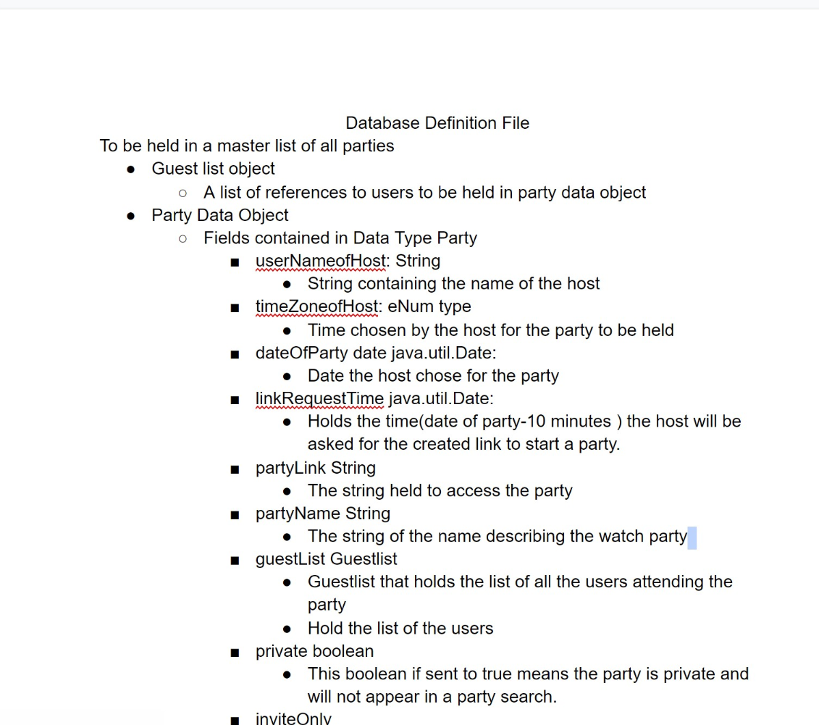
Data Definition File - >
Notes:
Ben

Slide 15
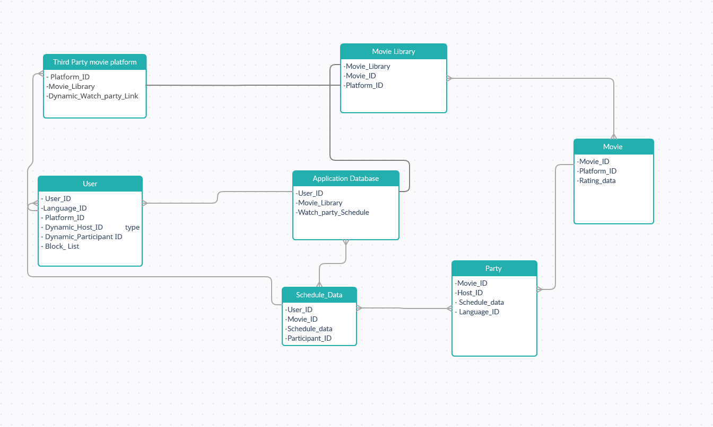
Database Design
Notes:
Samar

Slide 16
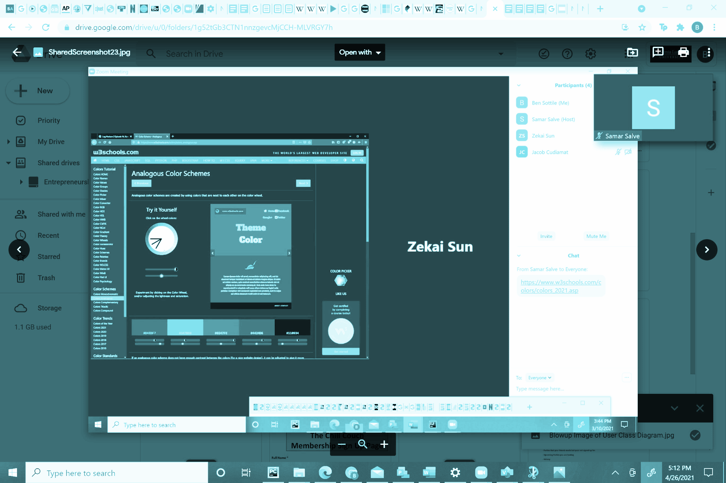
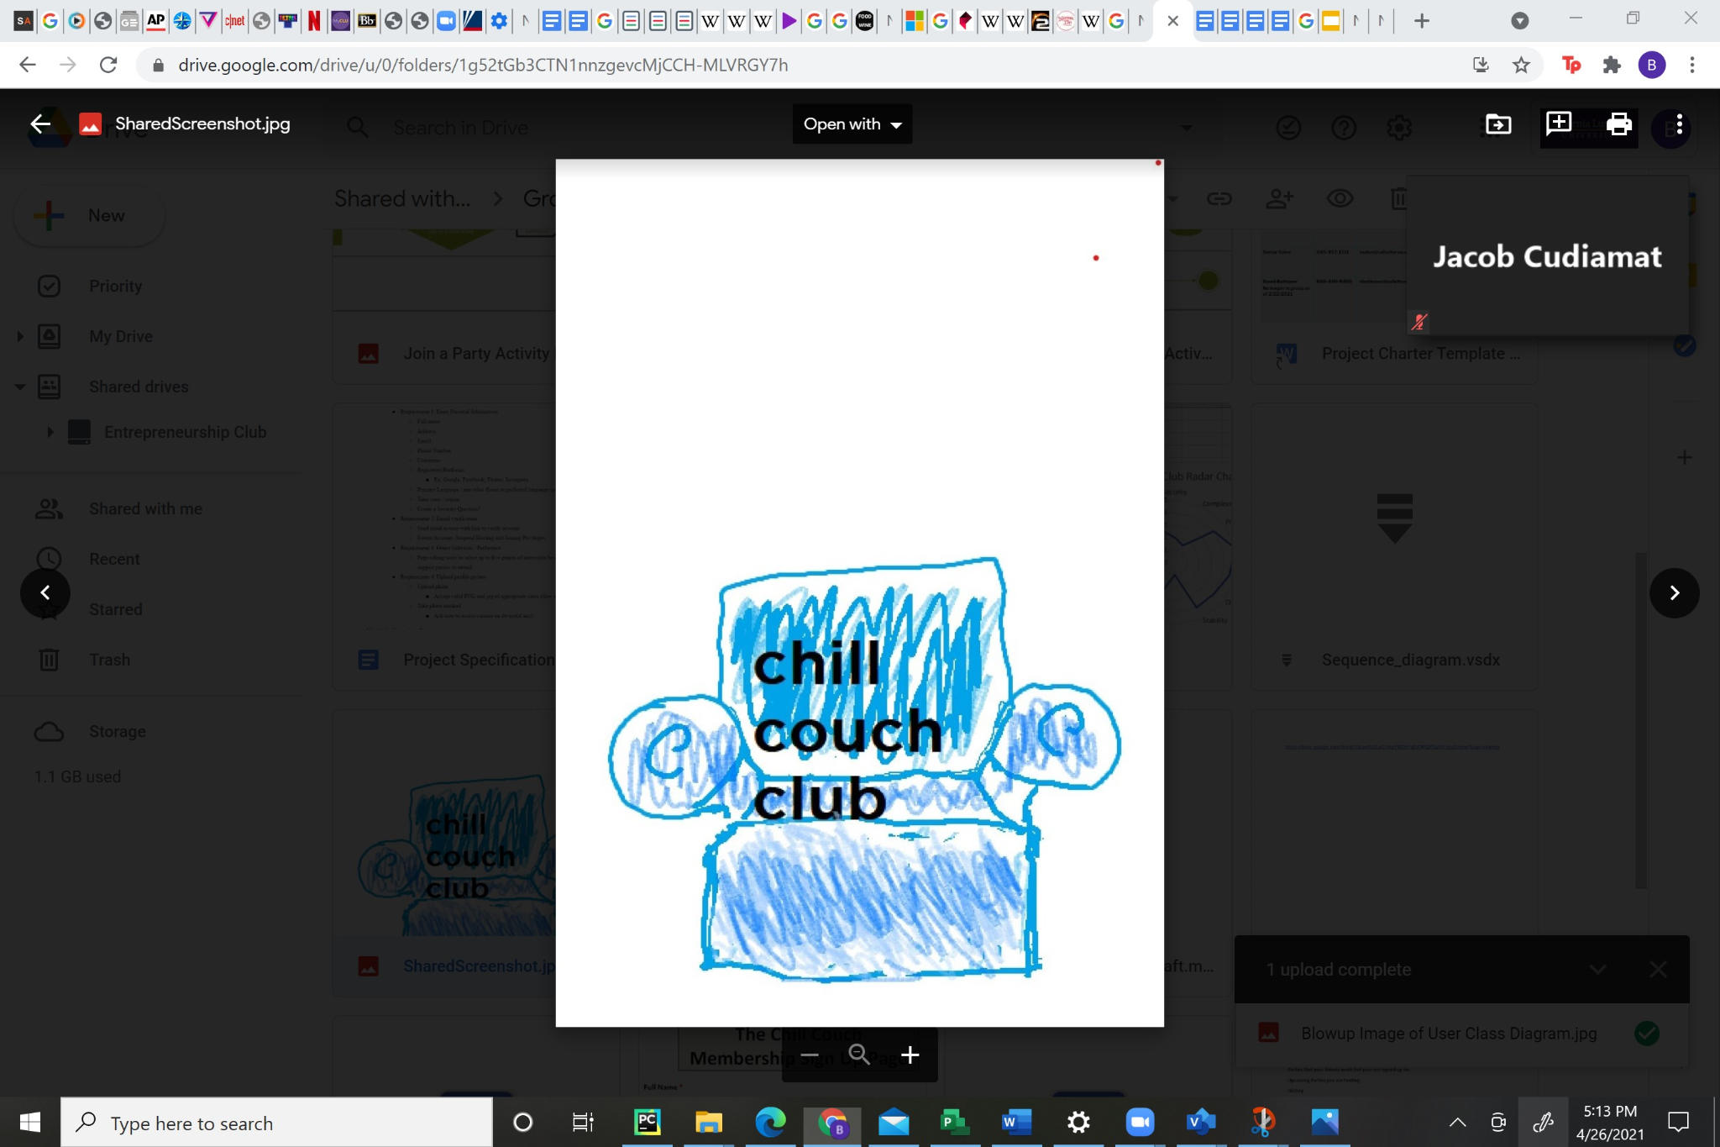
Graphic User Interface: Design Choices - > Theme and Logo
Notes:
Ben- Blue use of cool colors emulates a sense of relaxation
Logo emulates the Blue clues chair a child hood show of our demographic

Slide 17
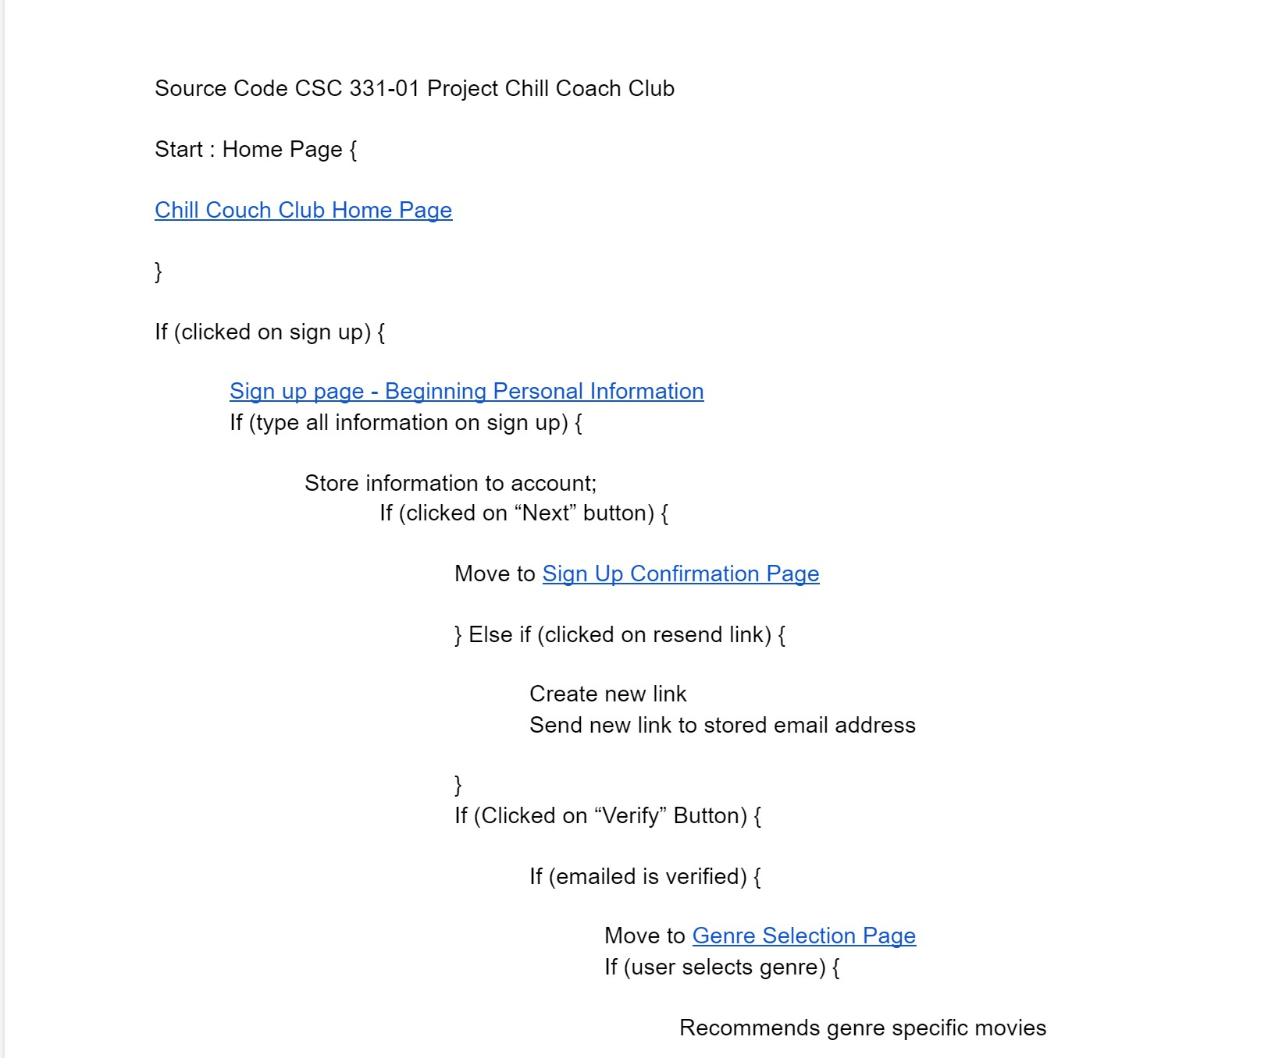
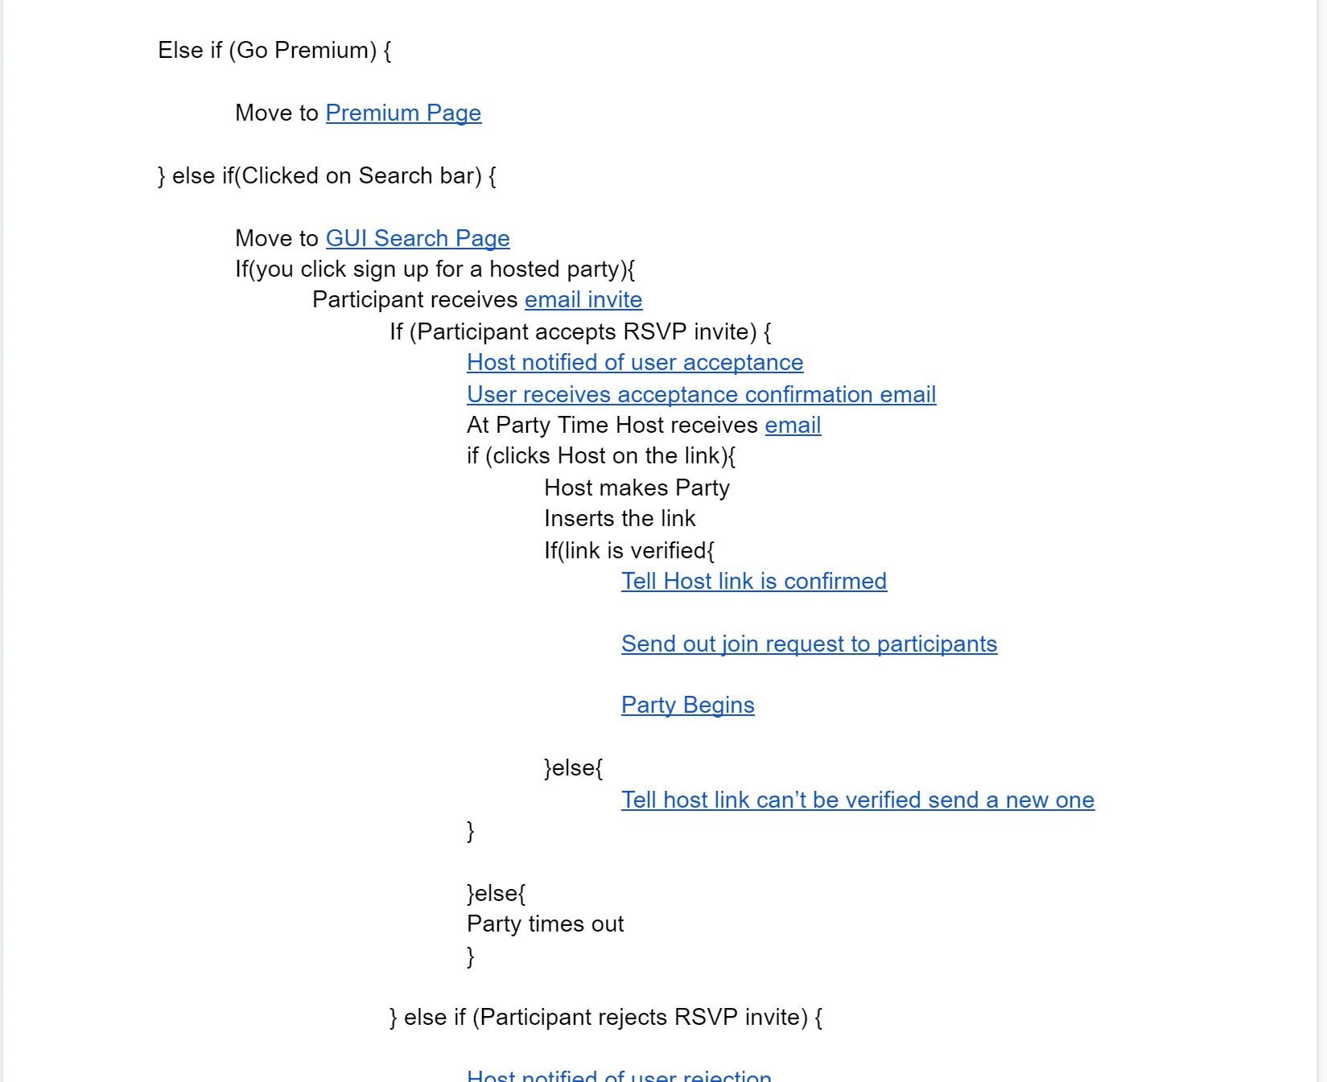
Source Code and UI Demonstration
Notes:
Ben

